Slide 1

Software for Synthetic Biology Workflows: How to Improve Your Productivity and Impact
Chris J. Myers, University of Colorado Boulder
Jacob Beal, BBN/Raytheon
Gonzalo Vidal Pena, Pontificia Universidad Católica de Chile
Daniel Bryce, SIFT

Slide 2
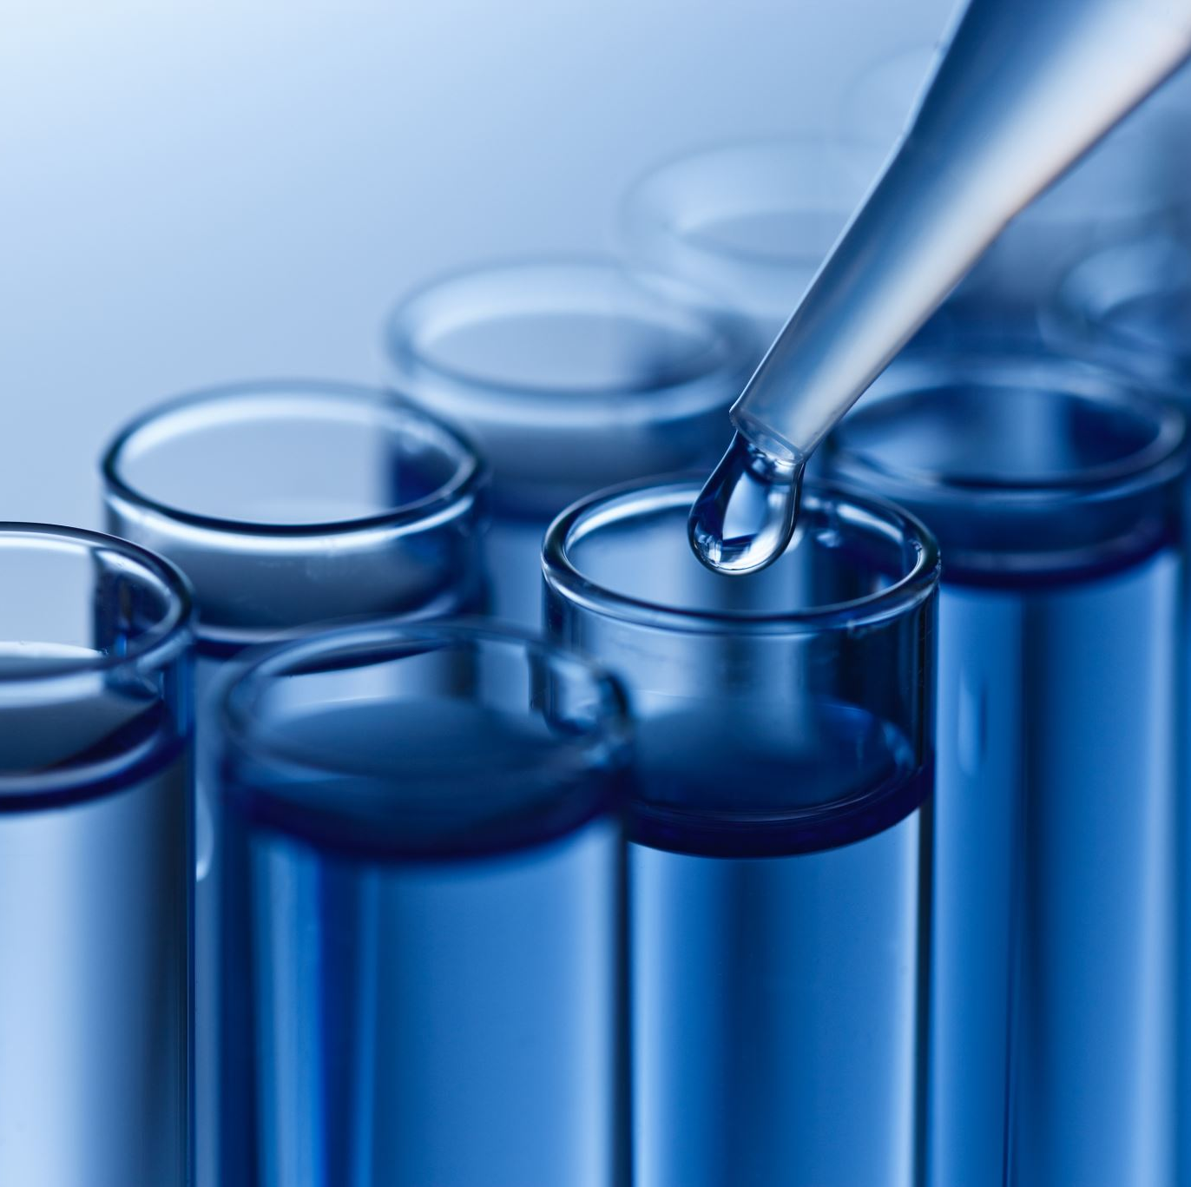
Workshop Organization
A modeling workflow for genetic design
A production workflow for the design of libraries of genetic constructs
A data management workflow for genetic circuit characterization experiments
A test and learn workflow for high throughput laboratory science

Slide 3

A Modeling Workflow for Genetic Design
Chris J. Myers, University of Colorado Boulder

Slide 4
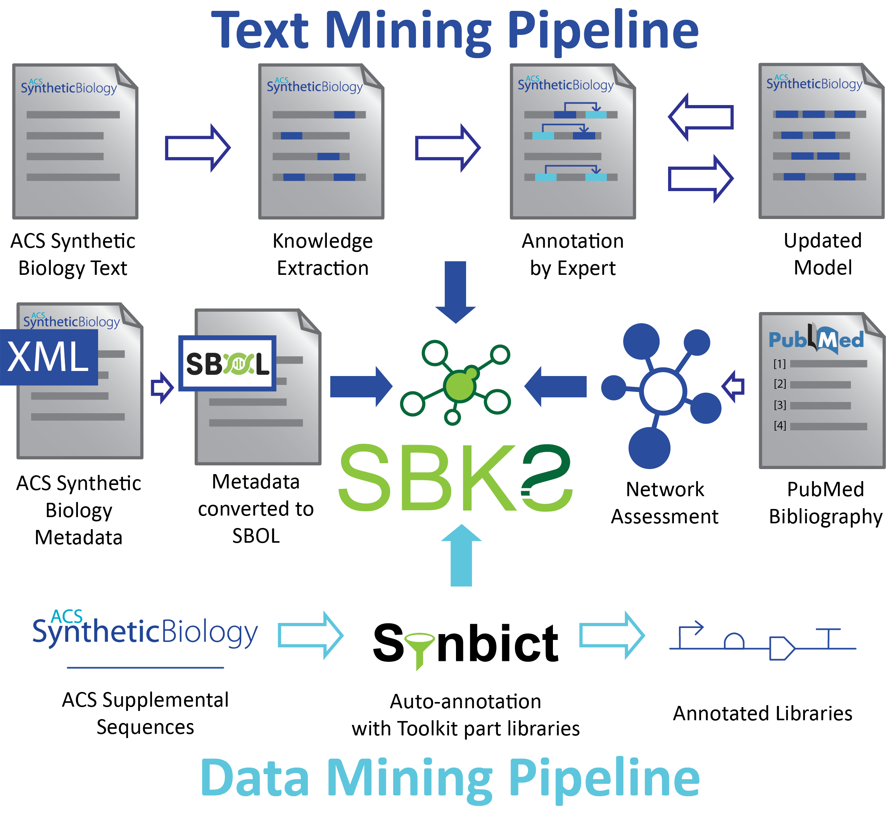

Synthetic Biology Knowledge System

Slide 5

Automated Model Generator Workflow

Slide 6
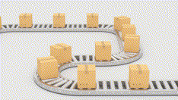
A Production Workflow for the Design of Libraries of Genetic Constructs
Jacob Beal, BBN/Raytheon

Slide 7



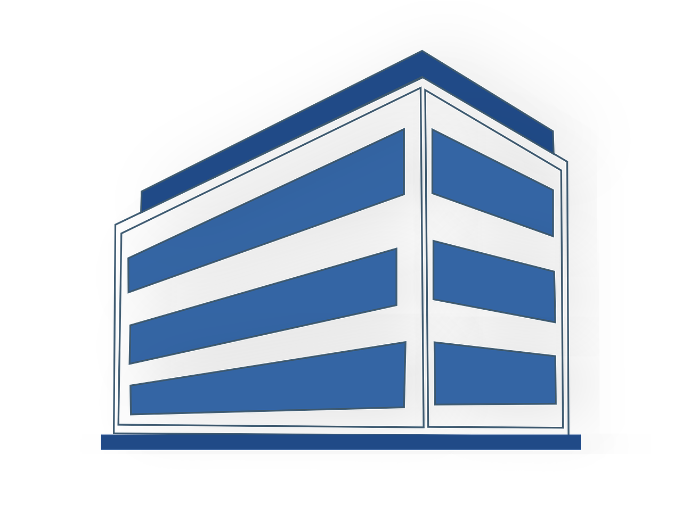




Online Collaborative Design
Engineering Committee
Design to order pipeline
FASTA
DNA Synthesis Company
Manufacturability issues
Notes:
Presentation Title
June 14, 2021
Speaker Name
7

Slide 8
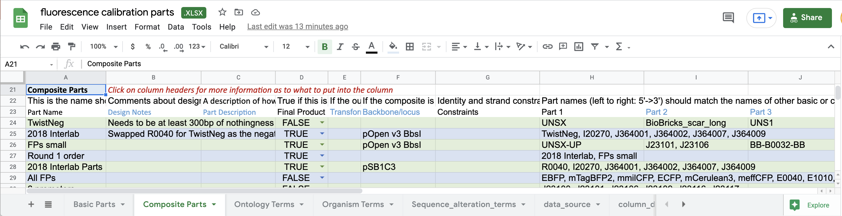
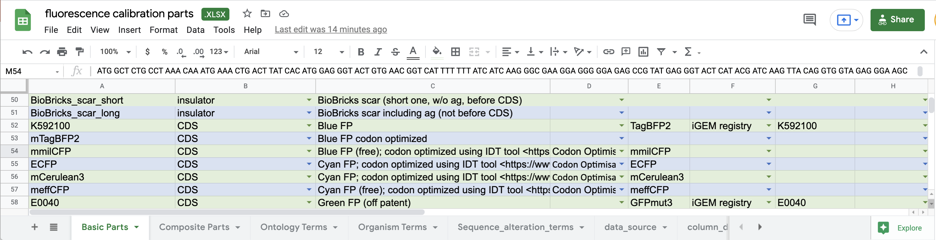
Construct Design with Google Sheets
Composite parts & backbones for an experimental campaign:
Basic parts to be composited:
Based on: https://github.com/SynBioDex/Excel-to-SBOL

Slide 9

A Data Management Workflow for Genetic Circuit Characterization Experiments
Gonzalo Vidal Pena, Pontificia Universidad Católica de Chile

Slide 10
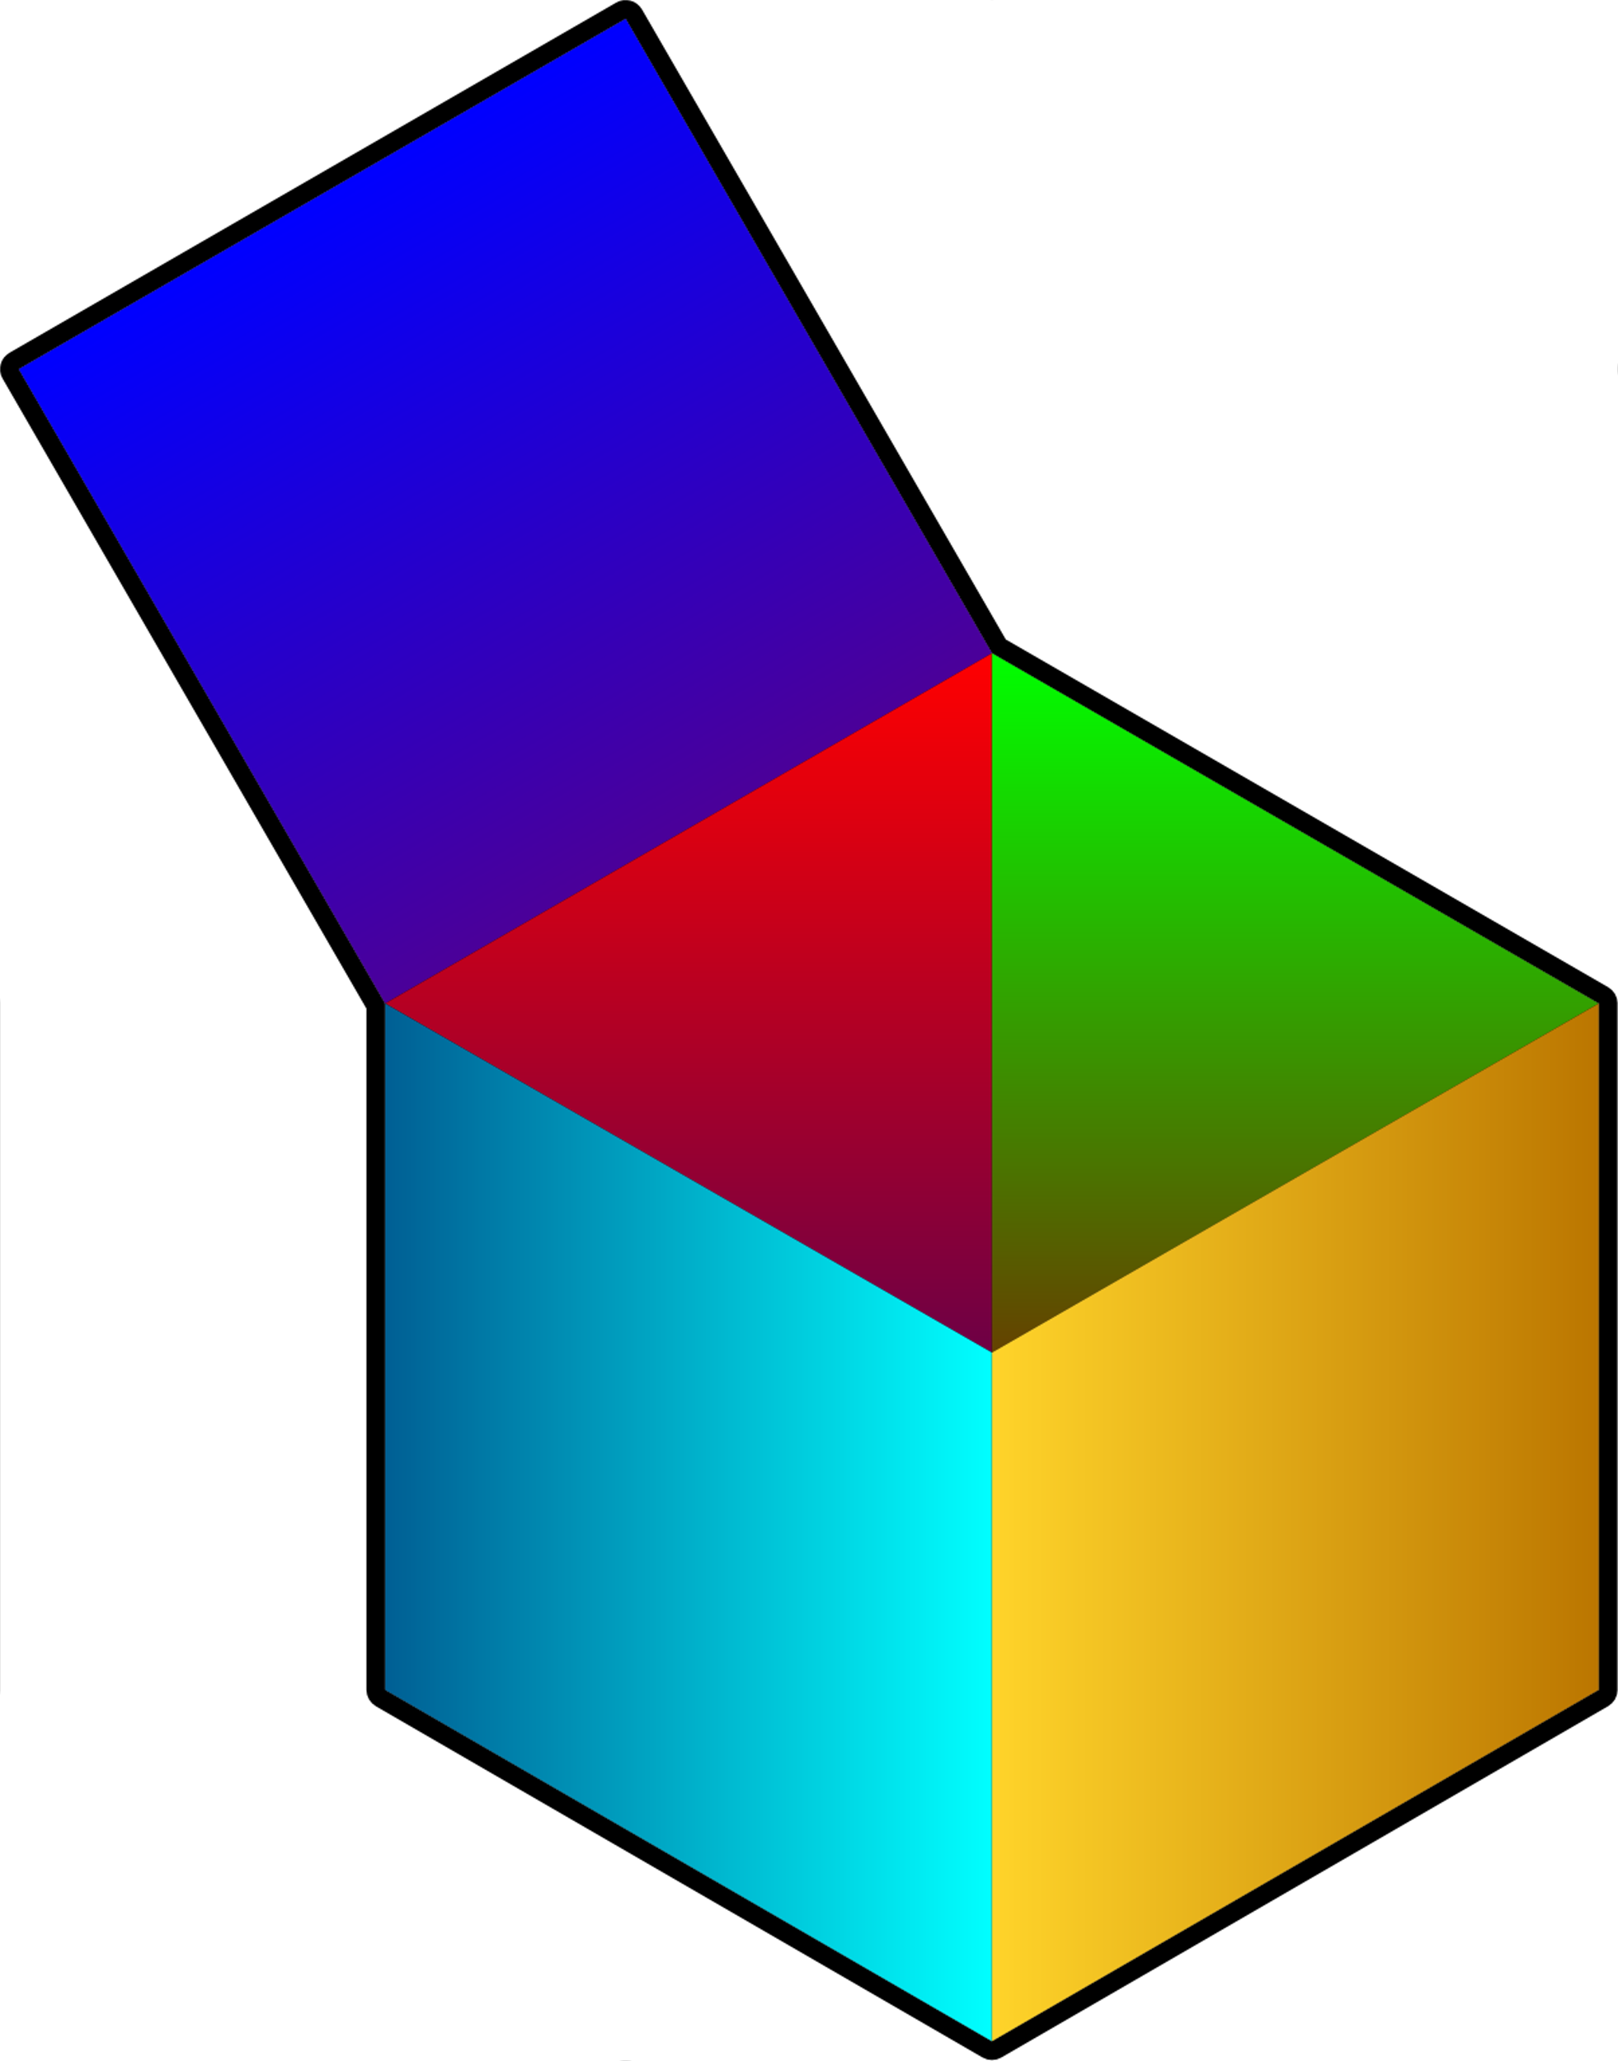
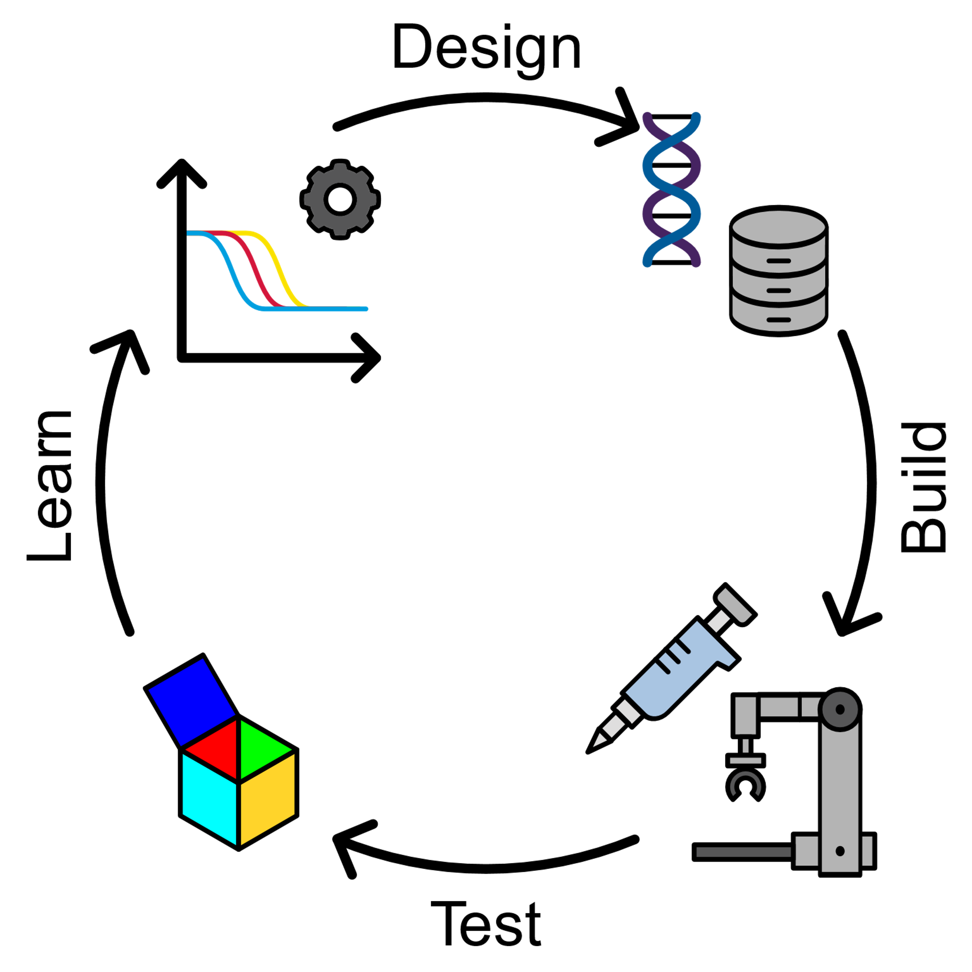
Flapjack
Flapjack is a data management and analysis tool for genetic circuit design.
Aim is to complete SBOL-based Open-Source Design, Build, Test, Learn workflow
Helps to analyze data in a more visual and user-friendly way.
System consists of a web app with a back-end data registry and analysis engine, accessible as a REST API.
Frontend provides powerful querying, plotting, and analysis tools.

Slide 11
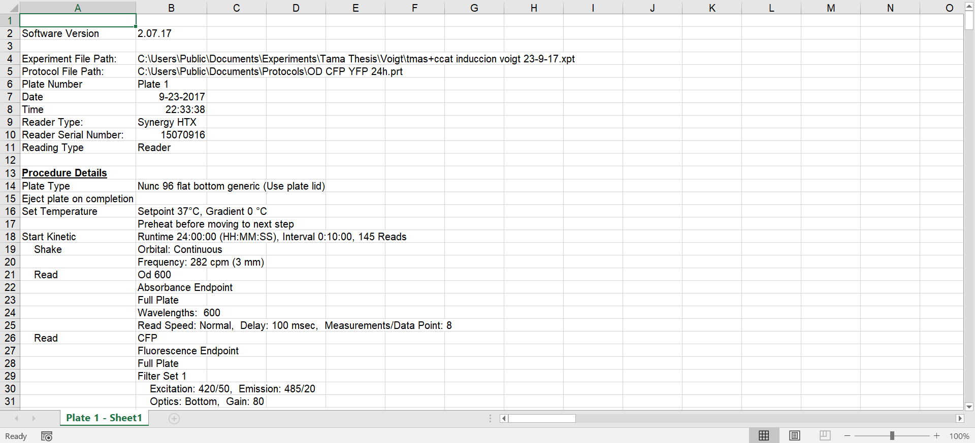
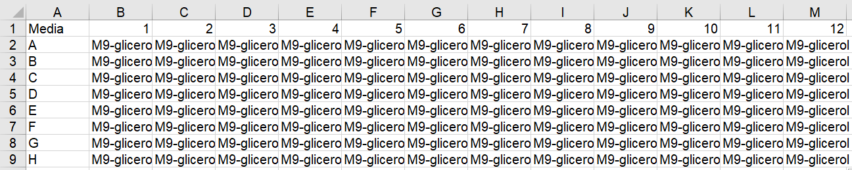
Uploading data: Plate reader
Flapjack allows you to upload data obtained directly from a plate reader.

Slide 12
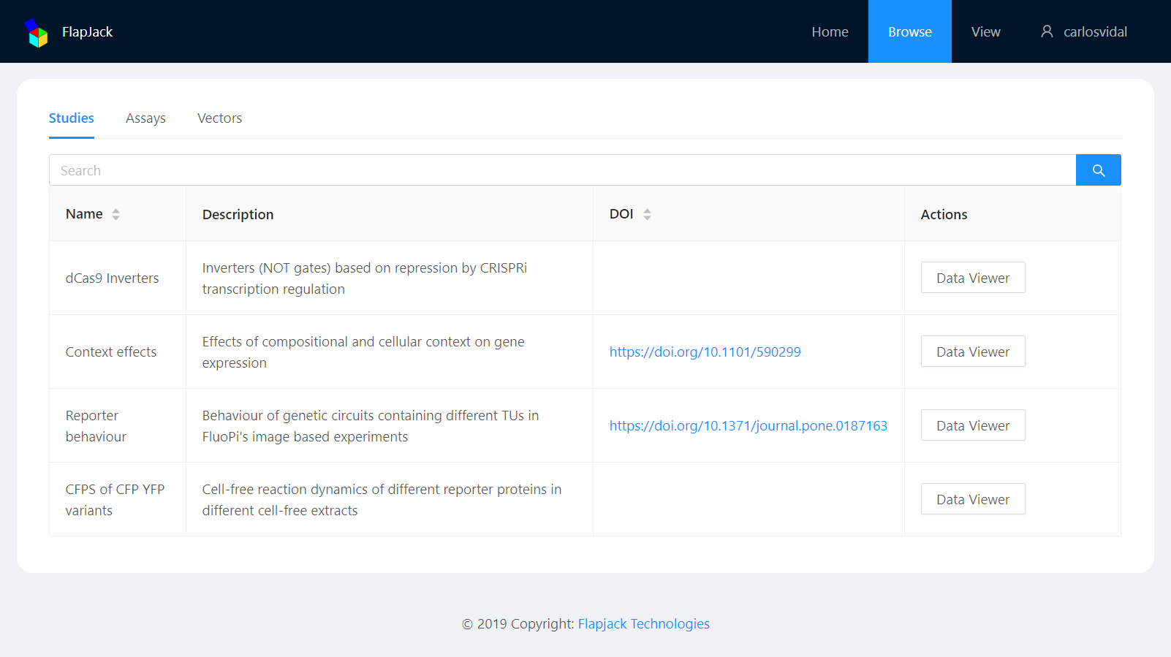
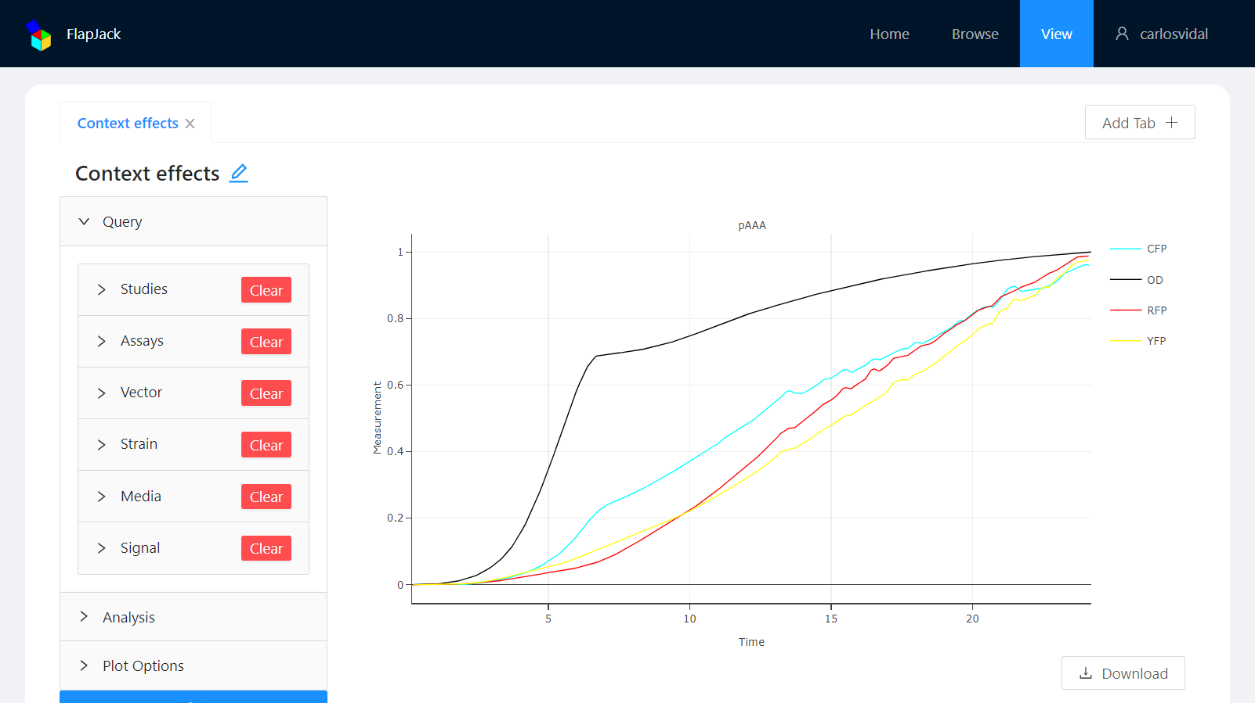
Browse and View page
Browse by Study, Assay or Vector.
Visualize and analyze data in an easy and straightforward manner.

Slide 13
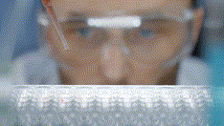
A Test and Learn Workflow for High Throughput Laboratory Science
Daniel Bryce, SIFT

Slide 14
DARPA SD2: Round-Trip Experimental Pipeline
Metadata capture, curation, and linking mediates human hand-off and accelerates end-to-end design to analysis

Slide 15
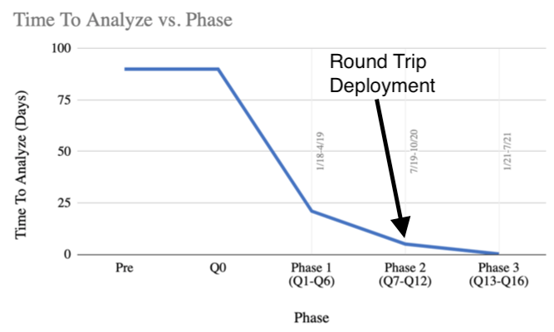
DARPA SD2: Round-Trip Experimental Pipeline
Round-Trip Software Architecture
Round-Trip achieves > 120x speed-up (3 weeks to 4 hours) in the time to generate actionable analyses, compared to initial ad hoc manual processes. Metadata makes the automation possible.

Slide 16
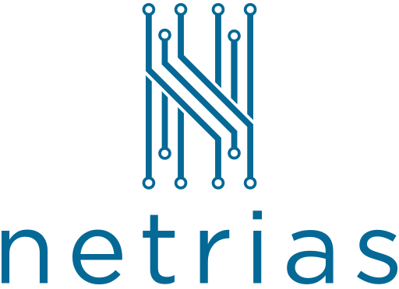







SD2: Round-Trip Experimental Pipeline

Slide 17
Invitation
Look forward to seeing you at the workshop at the top of the hour.

